Slide 1


ARABIC DIALECT CLASSFICATION
By: Mariam Waleed

Slide 2









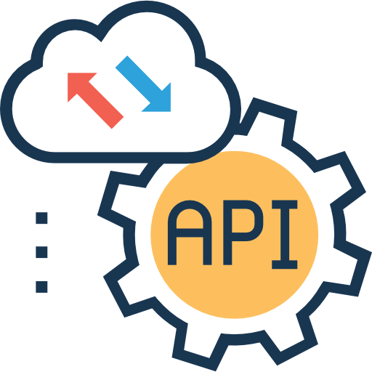







Pipeline

Slide 3

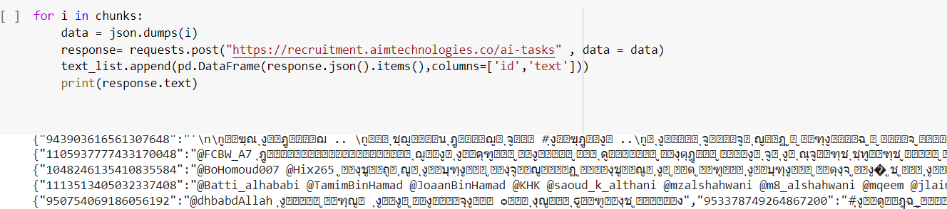
Data Collection
Fetching data using requests library as json
Fetching it as 1000 by 1000 using for loop
Convert the result dic to pd
Saving the result at csv file to work on it.

Slide 4
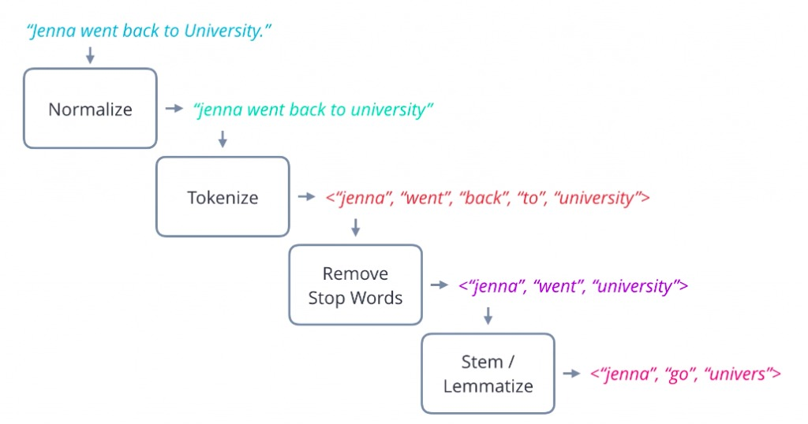
Data Preprocessing

Slide 5
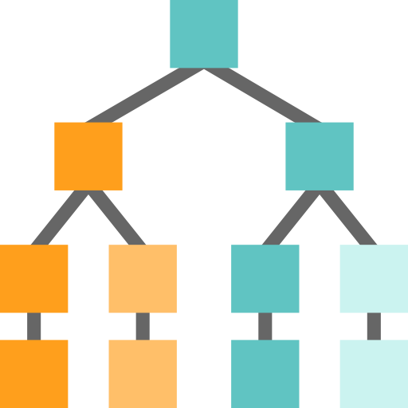
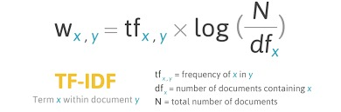
Text Representation
TF-IDF:
Focus on unique words in the corpus
Give words/n-gram a weight based on it's frequency
very useful in many domains

Slide 6
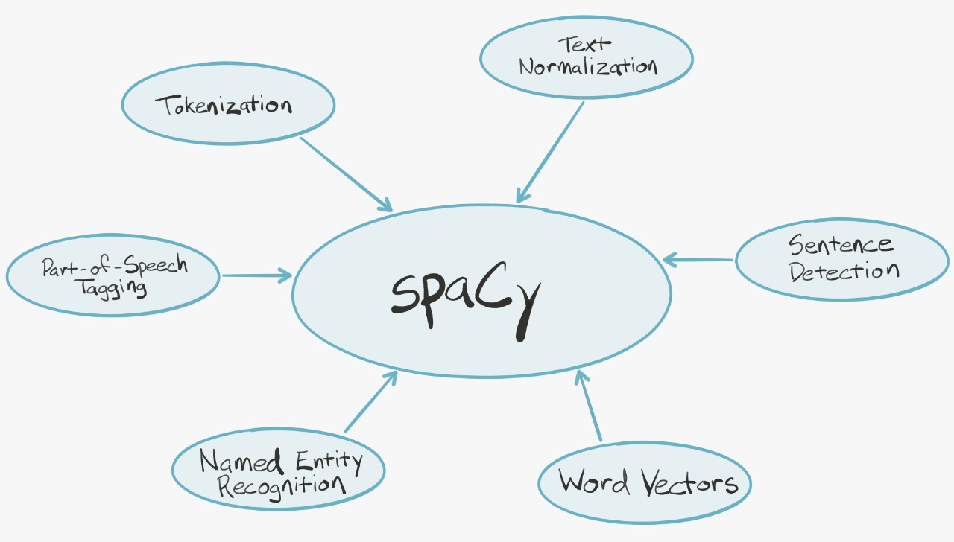
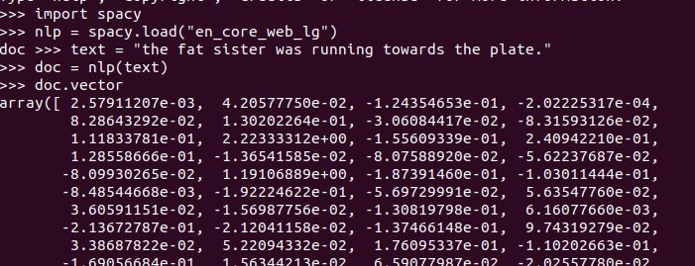
Text Representation
Word2vec(pretrained) :

Slide 7
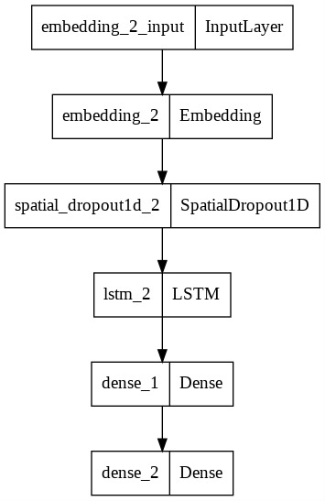
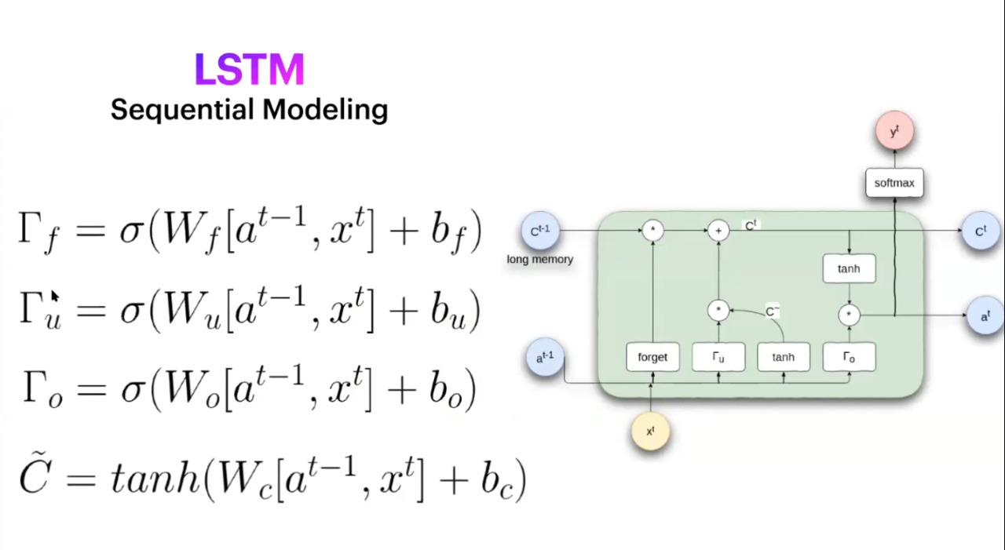
Deep Learning Models:

Slide 8
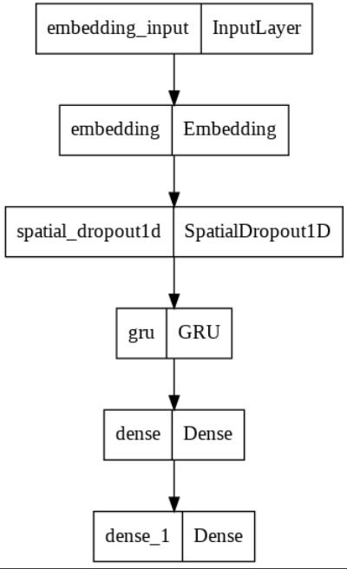
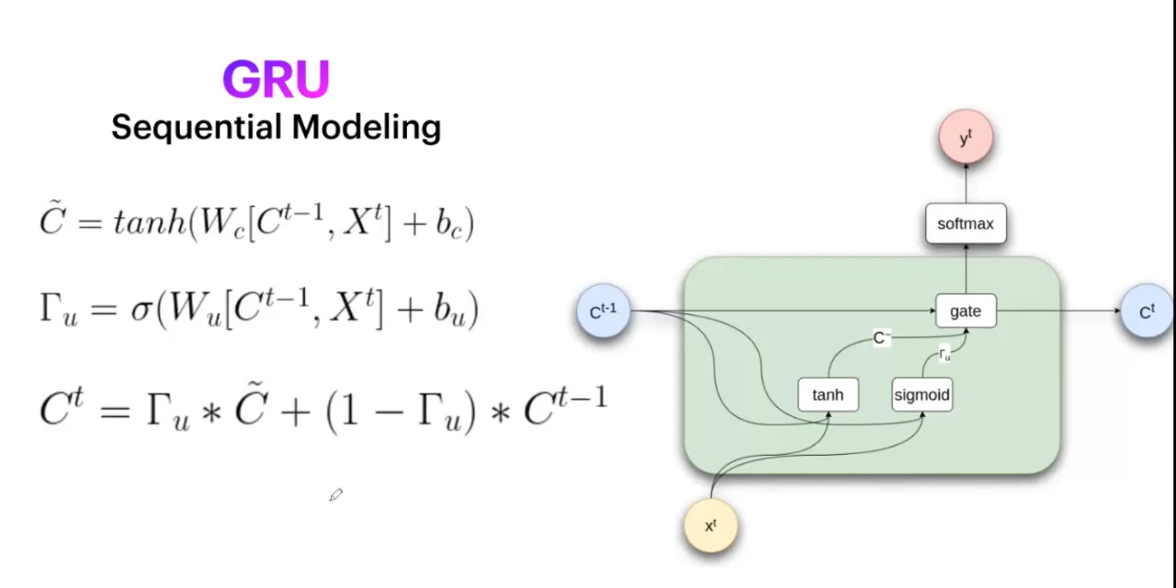
Models Deep Learning:
GRU (Architecture):

Slide 9

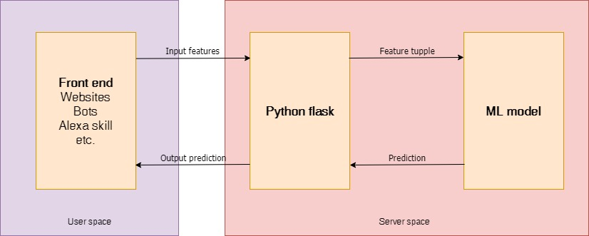
API

